Slide 1
Examining T2DM Study Documentation for Replicability and Perspective
Created by Molly Swisher and Gabriel Morrison

Slide 2
4 Goals of the T2DM Study
How do features correlate with one another
How do features correlate with samples
How do samples correlate with one another
Examine biological, medical, and diagnostic significance

Slide 3
Paper 1 - Glycated lysine-141 in haptoglobin improves the diagnostic accuracy for type 2 diabetes mellitus in combination with glycated hemoglobin HbA1c and fasting plasma glucose
Hypothesis: Specific glycation sites in plasma proteins are potential biomarkers and could allow for early diagnosis of T2DM when used in conjunction with established clinical parameters, such as HbA1c and FPG
Aim: Find relationships between newly diagnosed T2DM samples and the features(27 selected glycation sites from 9 plasma proteins and the clinical parameters)

Slide 4
Paper 2 - Diagnostic Accuracy of Protein Glycation Sites in Long-Term Controlled Patients with Type 2 Diabetes Mellitus and Their Prognostic Potential for Early Diagnosis
Hypothesis: Due to their short half life, glycated proteins are potentially helpful in monitoring short term fluctuations in glucose plasma concentrations, specifically in long term T2DM samples, and may also be used in conjunction with existing clinical parameters to make reliable predictions when concerning the potential for T2DM within a given sample
Aim: Explore the relationship between 29 specific glycation sites from 10 plasma proteins and long term T2DM and prediabetic samples, which could make visible patterns between samples and possible subgroups for prediabetic samples. Ultimately, finding relationships between samples is the goal.

Slide 5
Paper 3 - Yet to be determined...
Hypothesis: Correlations between peptides and gene expression levels of the related proteins could provide invaluable knowledge in the biological and medical fields
Aim: Identify relationships between glycation sites and associate proteins to genes in order to identify biomarkers which not only aid in the diagnosis of T2DM but also in understanding the disease as a whole

Slide 6
Paper 1: Conception (Requirements)
Requirements: determine how to use the set of features to classify the data set of 48 newly diagnosed T2DM patients and the 48 nondiabetic patients and then find the features that provide the best accuracy when used alongside FPG and HbA1c
Analysis methods (decision trees, etc.) that will classify data based on features
Inputs: sample #, features (peptide level, diagnosis)
Output: diagnostic accuracy

Slide 7
Paper 1: Conception (Pseudocode)
Major Processes:
Determine threshold for each feature
Create if statements to find diagnosis
Compare output diagnosis to actual diagnosis
System Architecture:
Input threshold
Main Function
Input classification
Pseudocode for Function to find Diagnosis:
Take in the threshold and features
Compare feature to threshold
Return diagnosis(either above, below, or equal to the threshold)
Output diagnosis
Output results
Pseudocode for Function to Compare Classifications:
Take in the classification produced from the function to find the diagnosis and the actual diagnosis
Compare the two for equality
Return the result(either TRUE or FALSE)
Function to find diagnosis
Function to compare classification

Slide 8
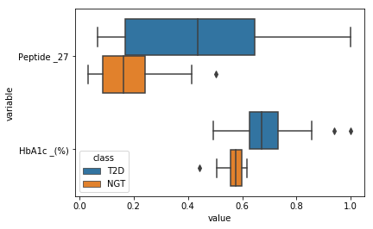
Paper 1: Methods (Box Plot Graphs)
Box Plot Graphs- Used to observe visual differences between features. Identifying outliers, spreads, and medians aid in determining potential accuracy builders in decision tree algorithm. Shown below are the box plots for HbA1c and Peptide 27, candidates for high accuracy diagnosis.

Slide 9
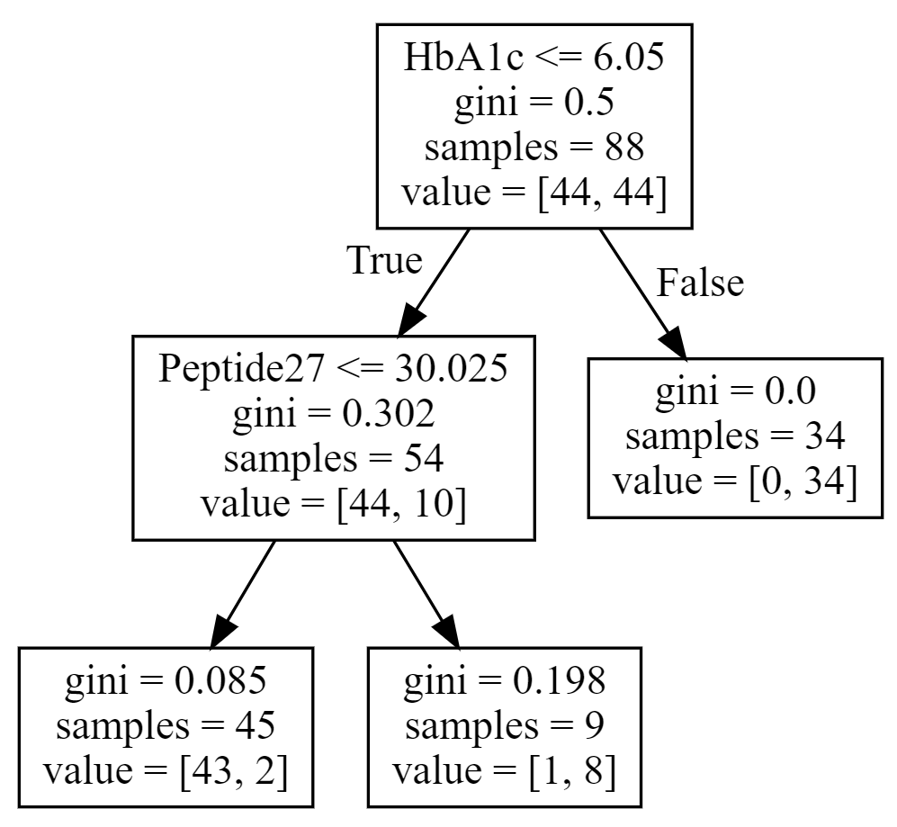
Paper 1: Methods (Defining K-Fold and Trees)
K-Fold Cross Validation- Folding a data set into different groups, one fold of the data trains the validator to recognize patterns in the data, then the remaining folds are sample sets which run through the validator and returns accuracies, sensitivities, and specificities. The use of cross validation determines which features/combination of features create the most desirable results.
Decision Trees- Often determined by an algorithm, a decision tree is used to create a graphical interpretation of the results of conditional statements. Decisions trees can be followed in order to make predictions. Shown to the right is a decision tree which uses the predictions of the cross validation to generate conditions for the branches of the tree.

Slide 10
Paper 1: Methods (Cross Validation Results)
All Features
Accuracy: 89.5%
Sensitivity: 87%
Specificity: 92%
These numbers aren’t very good, but by narrowing down which features are used together could improve the results.
HbA1c and Peptide 27
Accuracy: 95.5%
Sensitivity: 93%
Specificity: 98%
By changing the pairings and what features are used together in the decision tree, we can find what will produce high averages for accuracy, sensitivity, and specificity. This pairing of features produces the best results.
Possible thresholds for HbA1c and Peptide 27 are 6.05 and 30.025, respectively.

Slide 11
Paper 1: Methods (Random Forest)
Random Forest: A supervised learning algorithm that builds a “forest” of decision trees, trains them, and then averages the results of the decision trees together. It is a predictive tool and by calculating accuracy, sensitivity, and specificity we can know how well the features can classify the samples.
All Features(n_estimators = 400, min_samples_split = 10, max_features = 5)
Accuracy: 95.75%
Sensitivity: 96%
Specificity: 95.5%

Slide 12
Parameter Tuning for Random Forest
n_estimators - for our data set, we found that using less than 300 decision trees resulted in a wider range of accuracies while more trees provided a tighter range
max_features - found that using more than about 20 features resulted in poor accuracies
min_samples_split - if this number is too high it negatively affects the accuracy will if it is too low it doesn’t make much of a difference
The combination of these parameters produces some of the best mean accuracies as well as individual fold accuracies. Although, just simply using 400 decision trees produces similar mean and individual accuracies but also has a better standard deviation for the fold accuracies.

Slide 13
Paper 1: Methods (Comparison)
The boxplots are helpful in visualizing how the features differ between samples in different classes. They can display which features may provide a better split in the data, but both the decision trees and Random Forest can provide a better idea of the diagnostic value of the features and provide how accurately sets of features can correctly diagnose samples. Decision trees are based on parameters and are prone to overfitting, and Random Forests randomly generates trees based off a given set of parameters.
Boxplot vs Decision Tree vs Random Forest

Slide 14
Paper 1: Conclusion (Comparison Paragraph)
After working with the decision tree algorithm, we worked on trying to recreate the results from Paper 1 and find the best combination of features. We eventually reached the same conclusion that the combination of peptide 27 and HbA1c provided the highest accuracy when used to predict a samples class. Our work with the decision tree and Random Forest provided similar values for the accuracy, sensitivity, and specificity when peptide 27 was used in conjunction with HbA1c.

Slide 15
Paper 1: Conclusion (Comparison Stats)
Paper 1 decision tree results for peptide 27 and HbA1c:
Accuracy - 96%
Sensitivity - 94%
Specificity - 98%
Our decision tree results for peptide 27 and HbA1c:
Accuracy: 95.5%
Sensitivity: 93%
Specificity: 98%
Our Random Forest results for peptide 27 and HbA1c:
Accuracy: 96%
Sensitivity: 94%
Specificity: 98%

Slide 16
Questions
Are there peptides that are likely to be co-glycated?
If so, determine medical significance?

